Slide 1
Gun Violence
Sponsor: Councilor Worrell
Team-2 Members: Jialin Yu(Team Representative), Yujie Yan, Jiahang Li, Youheng Yang
Motivation: Comprehend the issue of gun violence within the community, with a primary focus on District 4 and subsequently, the entire city, and its effects
Goal: Identify the contributing factors to violence in District 4, in comparison to other regions. ideally aid in the formulation of policies that can be useful in enhancing the District's condition.
Notes:
Project Title, Sponsor, Team Members
Project motivation:
What is the goal of the project?
What is the background needed to understand the project?

Slide 2
Work Division:
Jialin Yu: Shape Part, compared the population distribution in different districts.
Yujie Yan: Shooting Part, extracting victim and crime commitors’ information.
Jiahang Li: Violent & Crime Part, established what violence looks like in D4 and the whole city, extension data for school.
Youheng Yang: School Part, analyzed the attendance and dropout rate in school from different district part.
Data we use:
Data with Given sources
Crime incident report from 2015-2022
Shots fired
Shapefile of Boston districts
Violence
Firearms Dealer transactions
Student Discipline Data Report
Boston massachusetts police district data
MBTA stops
School attendance
Score Record
Data we found
Police Station location
School distribution
Notes:
What have you done so far? (meetings, data analysis)
How did you divide up the work among the team
What data have you used? If you collected data, how did you do that?

Slide 3
Factors that are correlated with shooting violence:
Resident diversity
firearms transaction amount
MBTA stops number
Challenges about data:
Dataset without location information.
Dataset from different time periods
Lack of description for attribute acronyms
Notes:
What (early) results or observations do you have?
What (early) visualizations can you show?
What challenges did you encounter working with data?

Slide 4
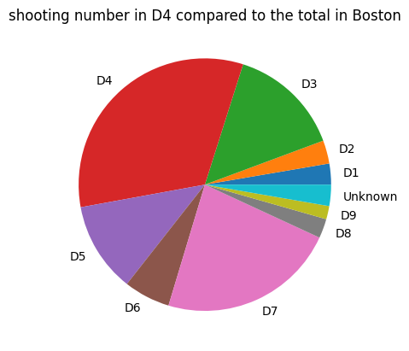
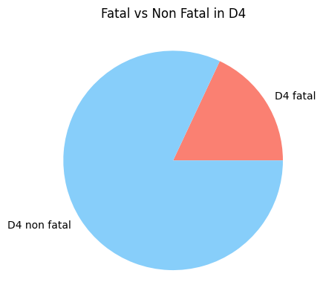
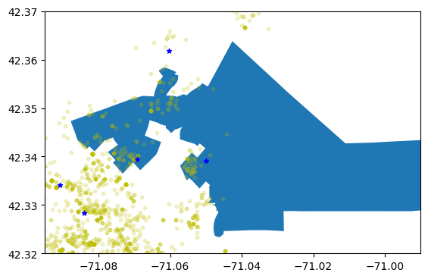
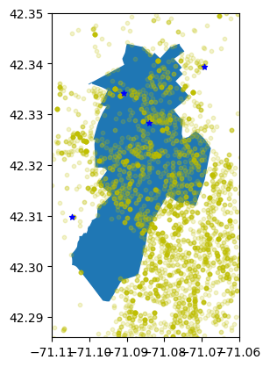
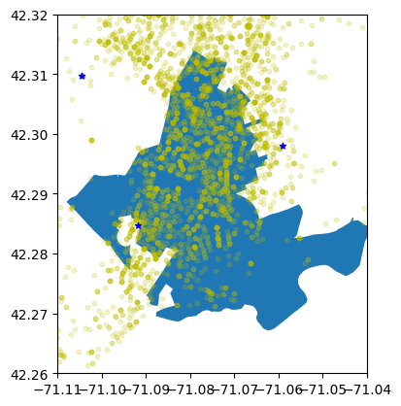
Shootings in D4 compares to other district in Boston is much higher

Slide 5
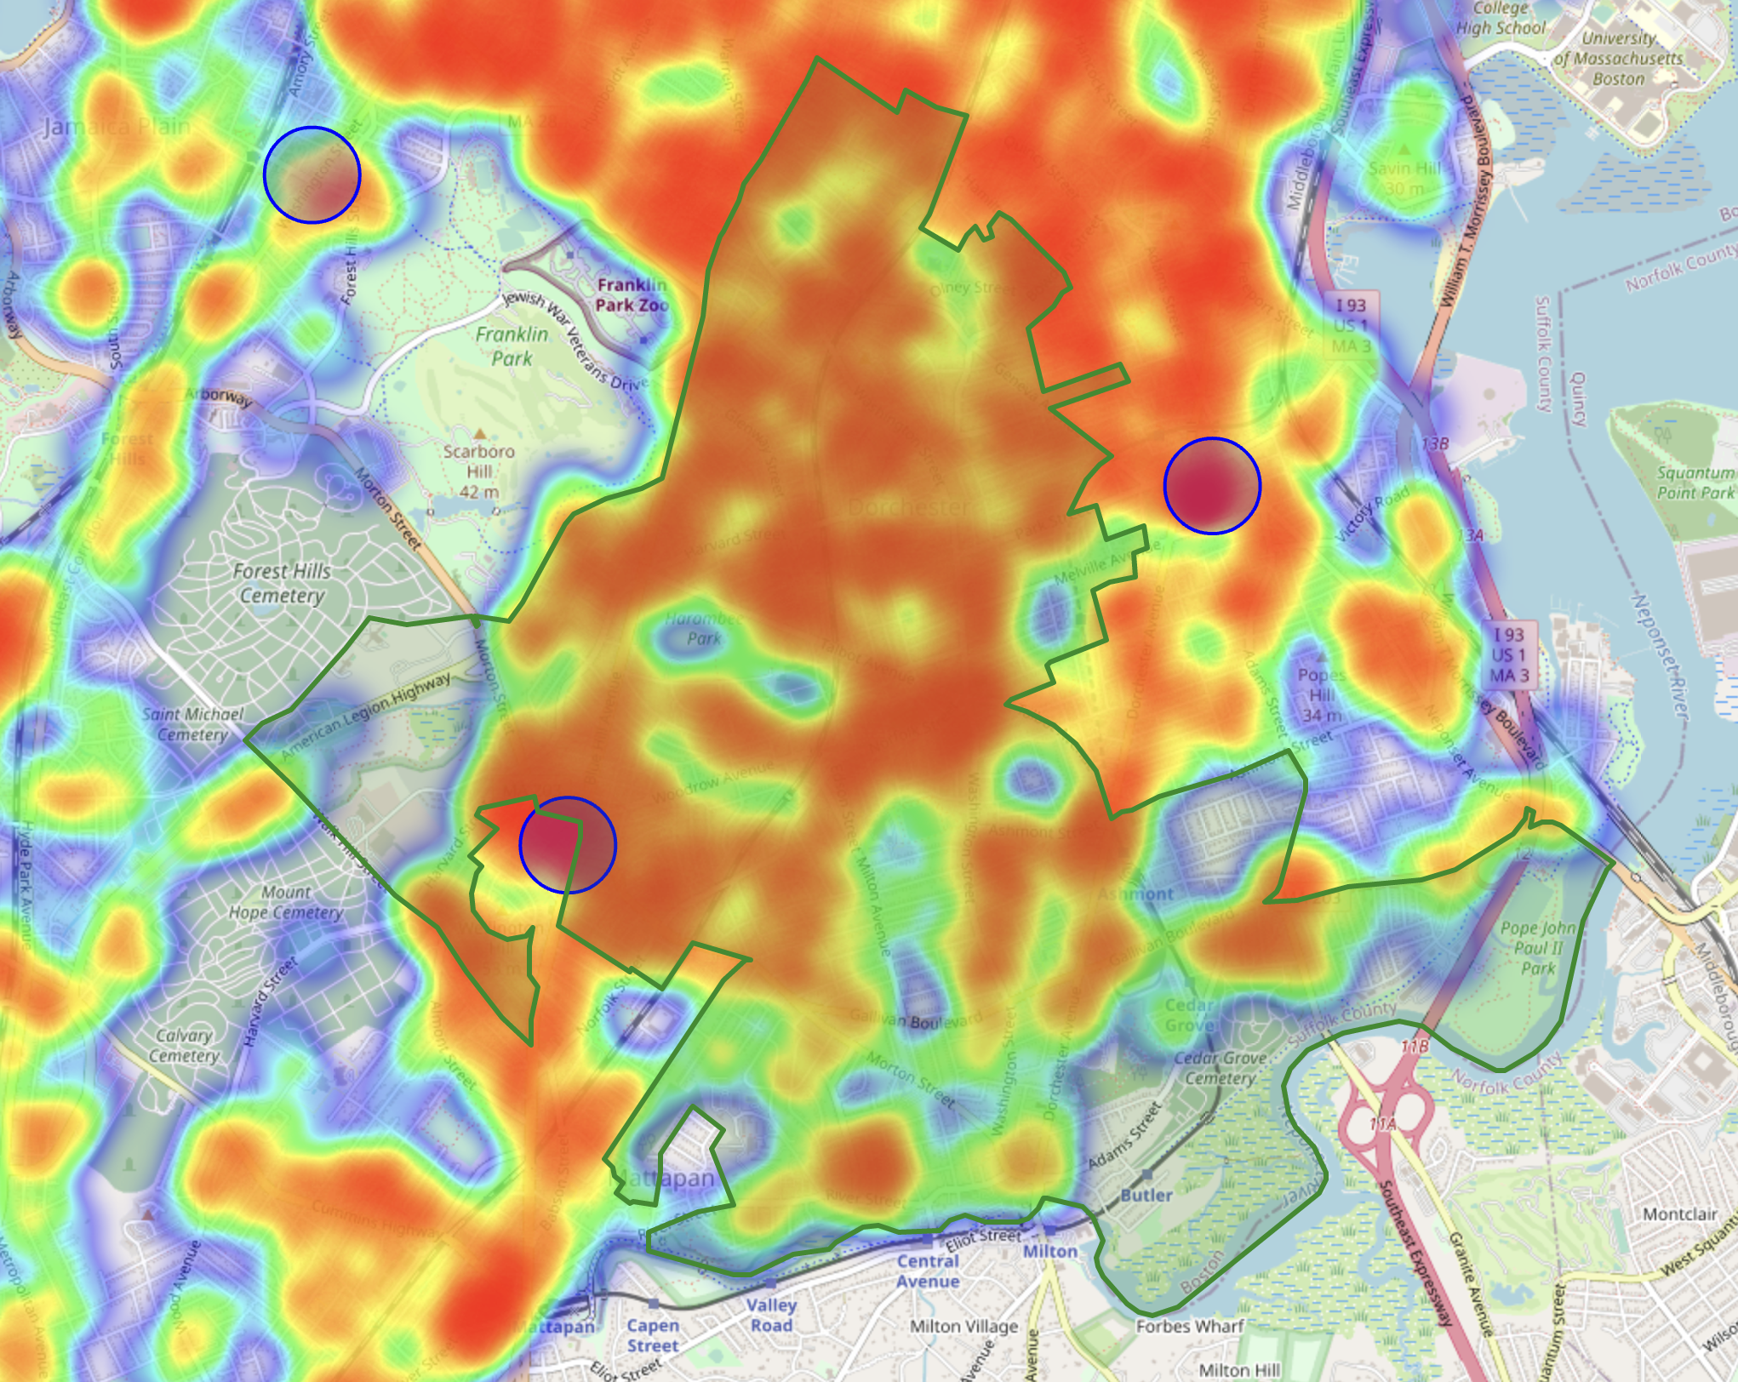
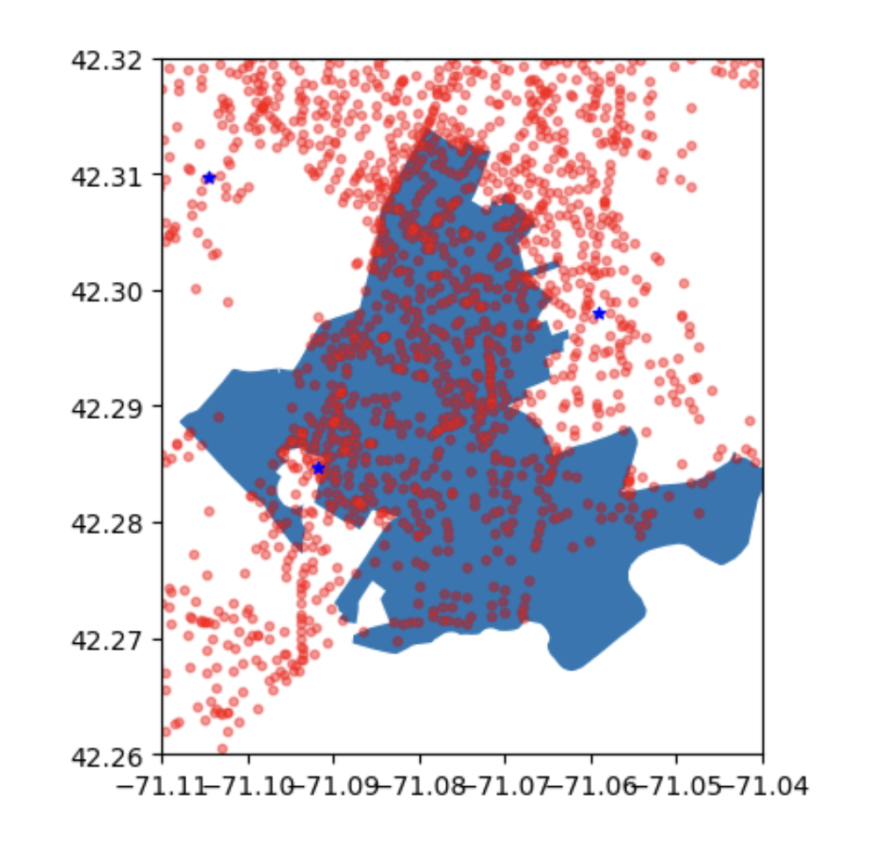
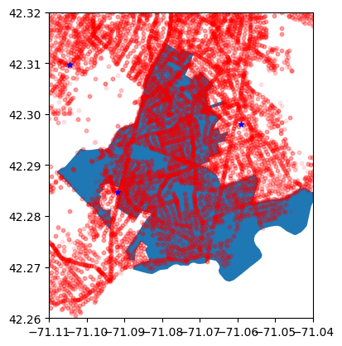
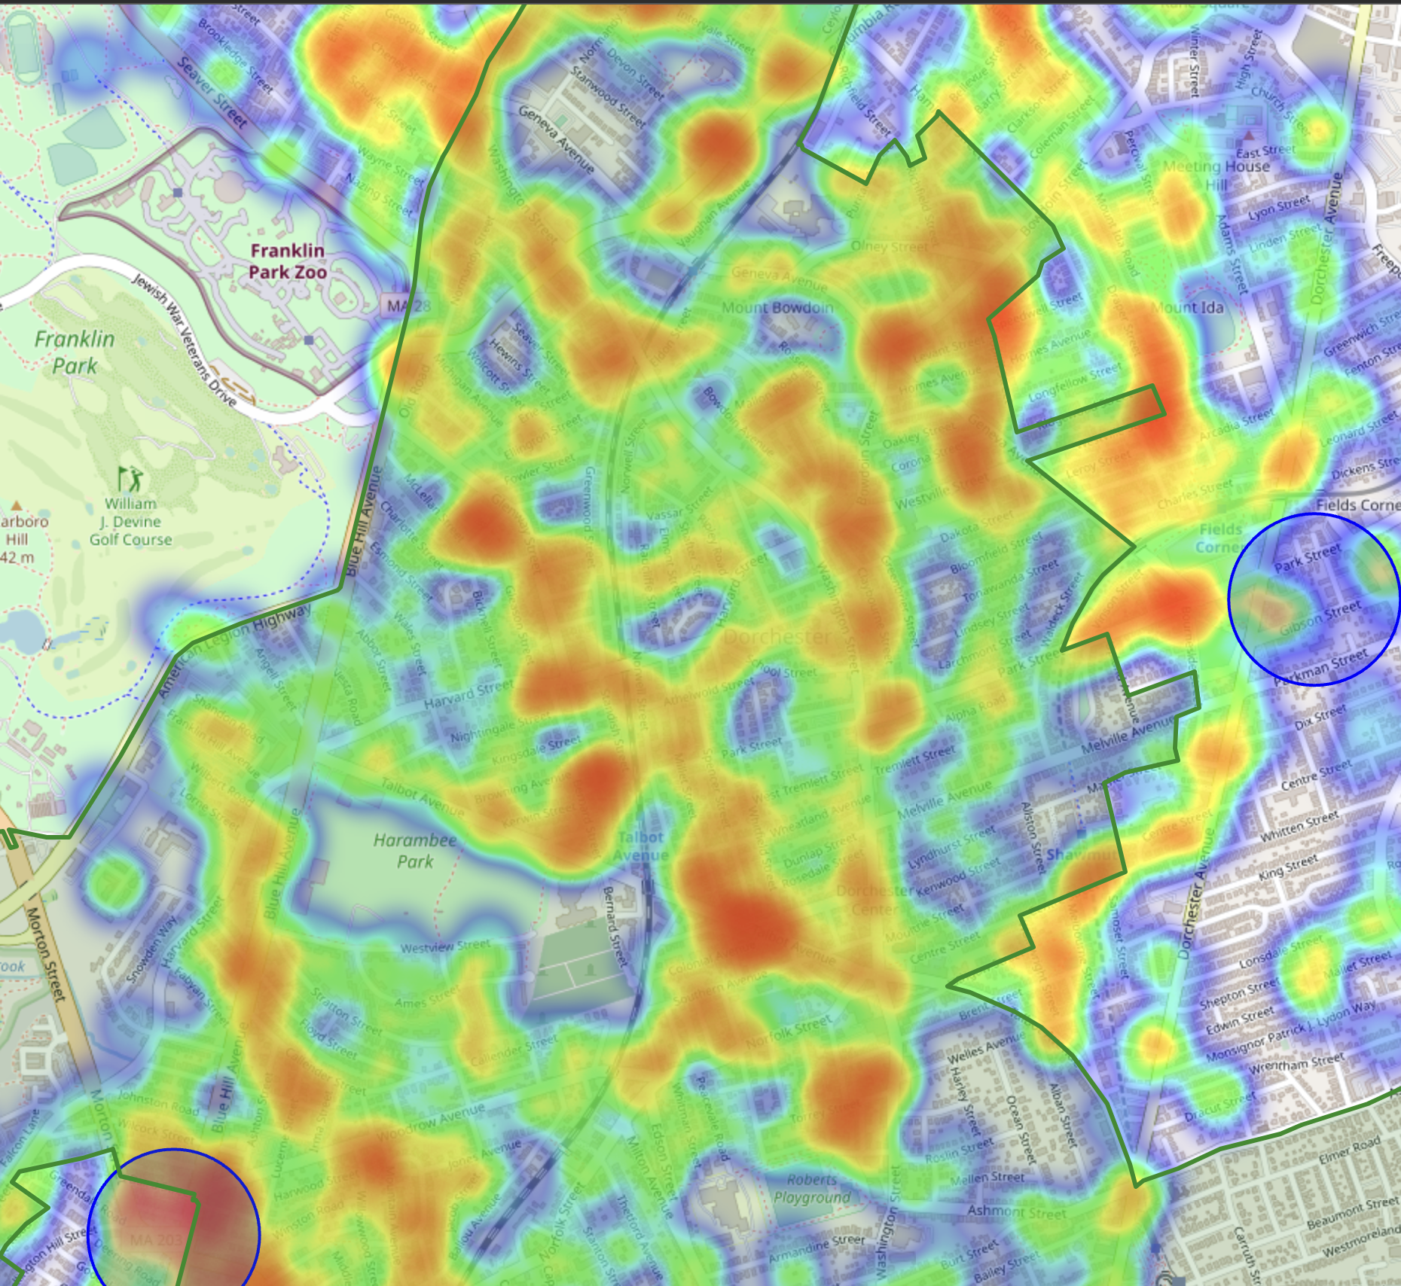
Crime distribution concentrate in Main Street
Focus on North-West
Happen mostly on Main Street
Blue Hill Avenue,Washington Street, Columbia Road, Norfolk Street
2023
2015 - 2023
Notes:
http://127.0.0.1:5500/spring23-team-2/deliverables/deliverables%202/map.html
http://127.0.0.1:5500/spring23-team-2/data/shooting_heatmap.html

Slide 6
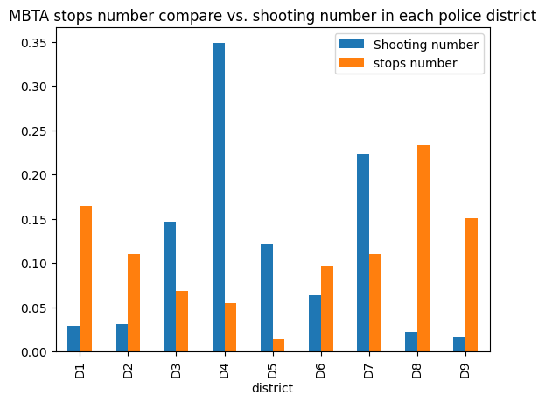
District with more MBTA stops tend to has less shootings

Slide 7
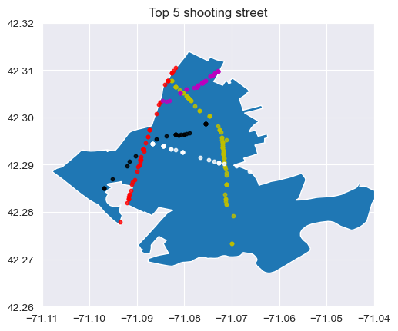
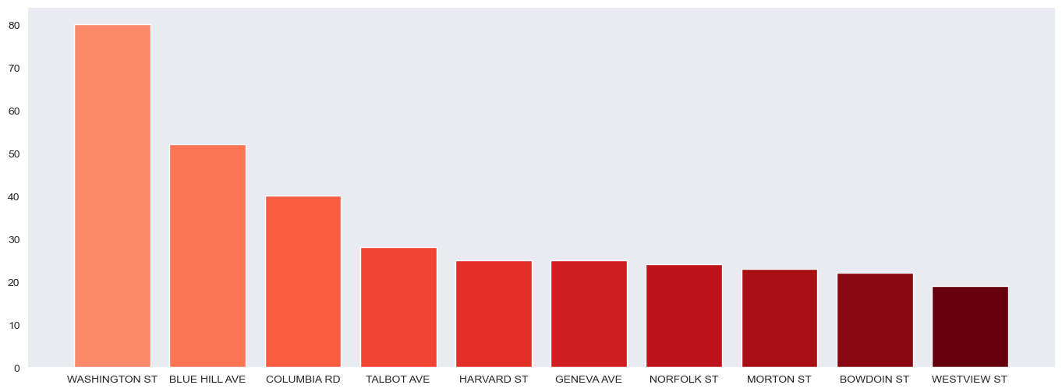
Street level shooting rate in D4
The yellow scatter points are shooting on washington street
The red scatter points are shooting on blue hill ave
The magenta scatter points are shooting on columbia rd.
The white scatter points are shooting on talbot ave.
The black scatter points are shooting on harvard st)

Slide 8
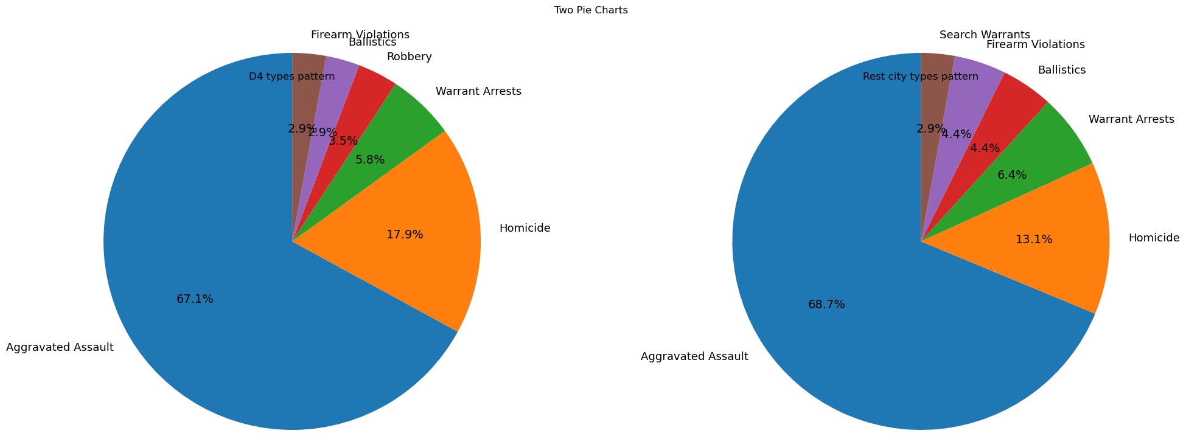
Type of shooting crime in D4 and rest cities
The aggravated assault is a major cause in shooting crime. And the type of shooting crime are similar. But D4 has more Robbery happened involving shooting. This indicates that poverty problem might be more severe in D4.

Slide 9
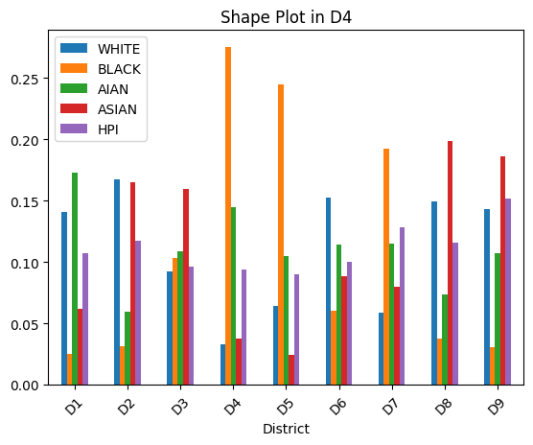
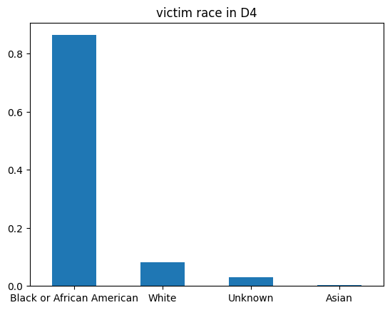
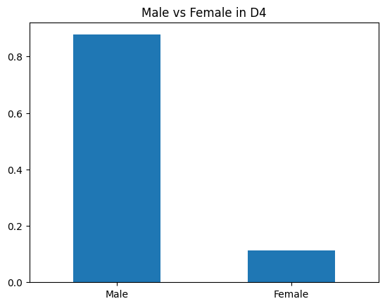
D4 has relative less racial diversity
Victims are mostly Male and with race of Black/African American
Plot 2.1 Plot 2.2
Plot 1.1

Slide 10
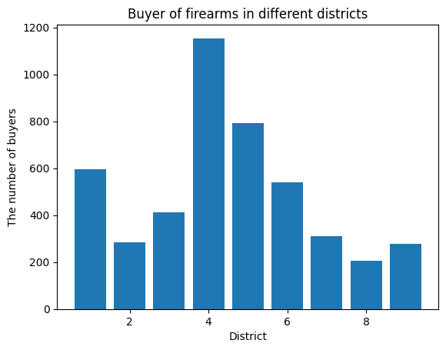
Drivers:
Resident Diversity
Gender Diversity
Higher number of firearms transactions.

Slide 11
School Part
School Disciplines
School Attendance
School Enrollment
School Performance
Limitation:
Only 300 - 400 school data in MA.
Only about 30 schools in Boston.
Only 2 - 4 schools in D4.
Notes:
Optional - *Slide 5* for the City Council Projects
Conclusion Slide
Now you’ve seen Team 1, 2, 3…here’s what’s next

Slide 12
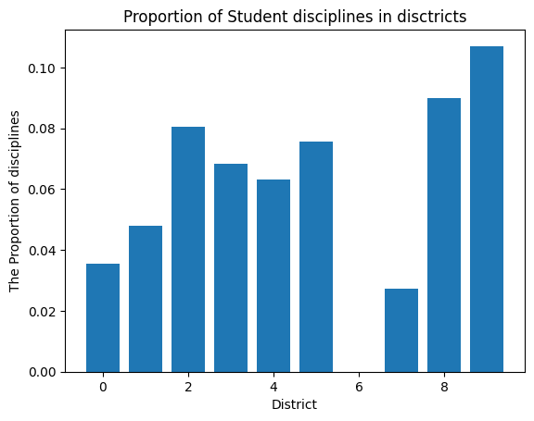
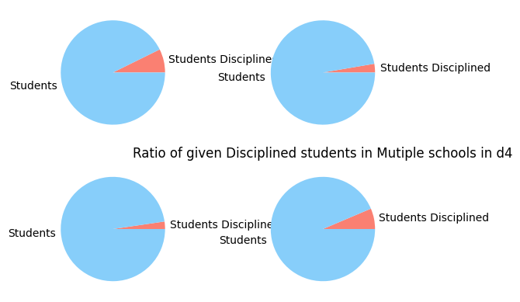
The School Disciplines in D4 compared to Boston

Slide 13
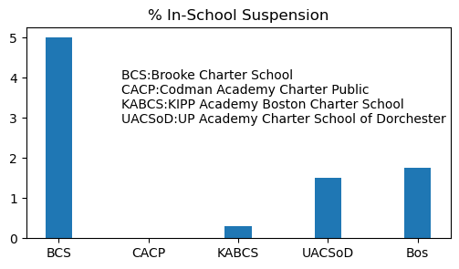
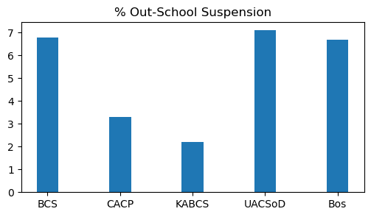
In-School and Out-School Suspension

Slide 14
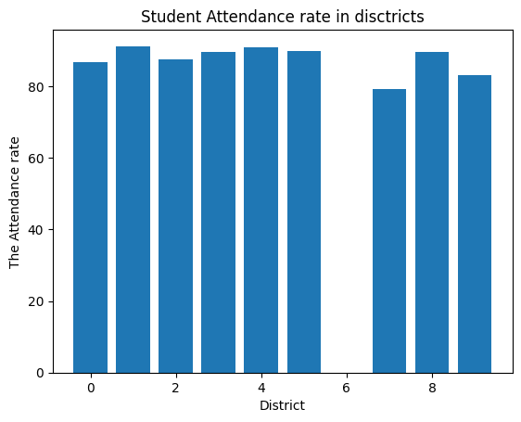
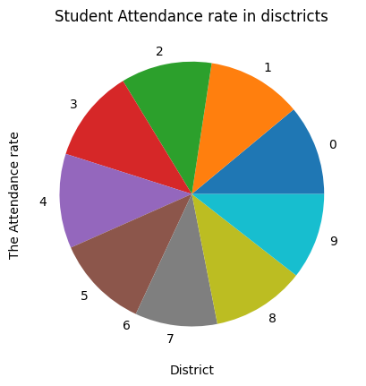
Attendance rate in Boston

Slide 15
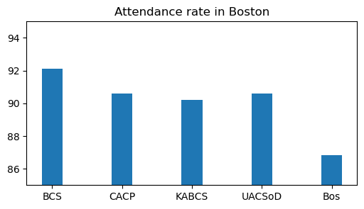
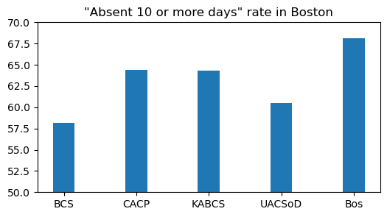
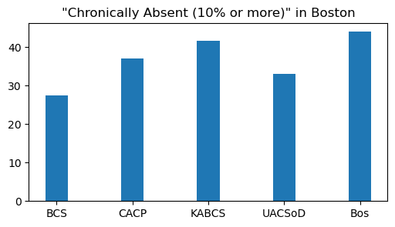
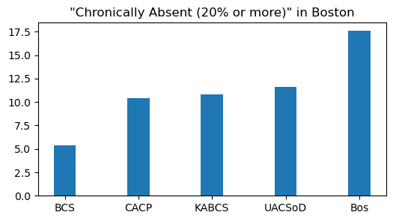
Higher attendance rate and less absence: Negative contribution to less gun violence
Less Chronically absent: No obvious positive contribution to less gun violence
Notes:
JL

Slide 16
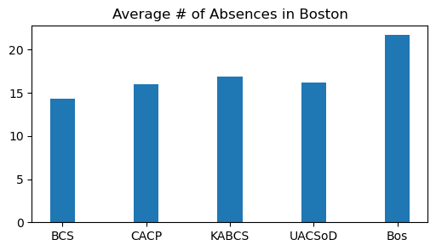
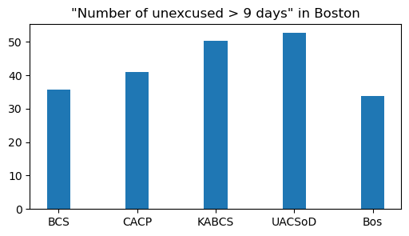
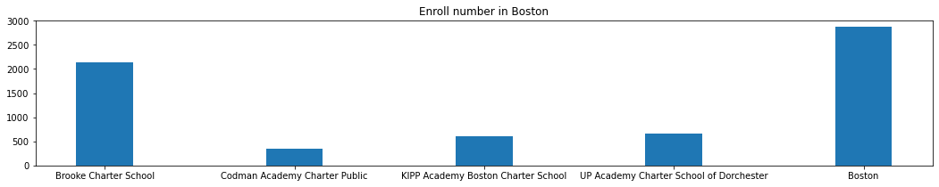
Less enrollment: more gun violence
Less absence: Ambiguous contribution to less gun violence
Notes:
JL

Slide 17
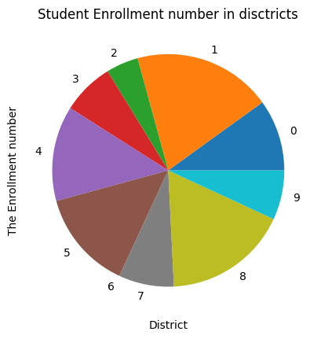
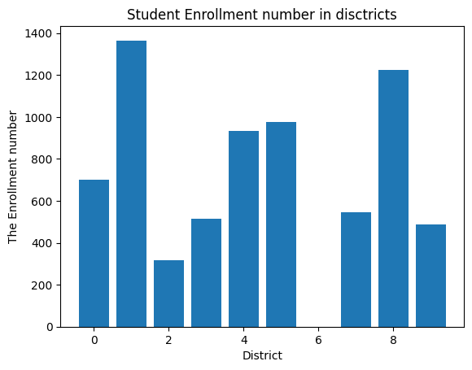
Student Enrollment Number in Boston

Slide 18
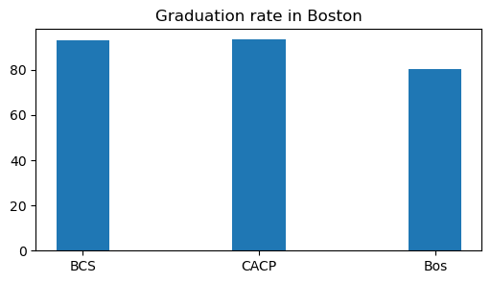
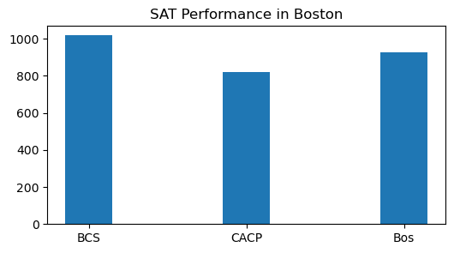
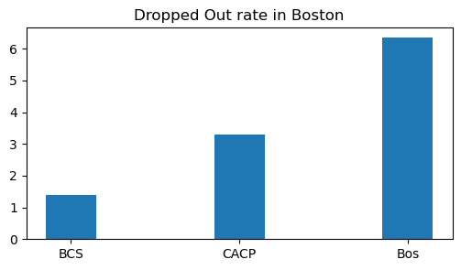
Higher Graduation rate: more gun violence
SAT Performance: ambiguous contribution
Less Dropped Out rate: more gun violence

Slide 19
Other challenges
Interactions of multiple drivers.
Limitations
Limited data type / available dataset
Incorrect geographical location data in the crime data reported by the police will lead to assumption of those violence happened in the rest of the city instead of D4.
Assumptions
Zip Code of D4 so that we can distinguish between districts for dataset without location coordinate.
Notes:
Any additional challenges you have encountered?
What limitations have you encountered? What assumptions have you had to make?
Based on the (early) results, what are the expected next steps?
What are you planning to do to complete your project?

